Slide 1
LECTURE 11 Trail, Path and Circuit

Slide 2
What you will learn in this lecture:
Walk, trail, path, closed walk, circuit, simple circuit
Euler trail
Euler circuit
Hamiltonian path
Hamiltonian circuit

Slide 3
The seven bridges of Königsberg
Question:
Is there a way for a citizen of Königsberg to find a route which crosses each bridge exactly once?

Slide 4
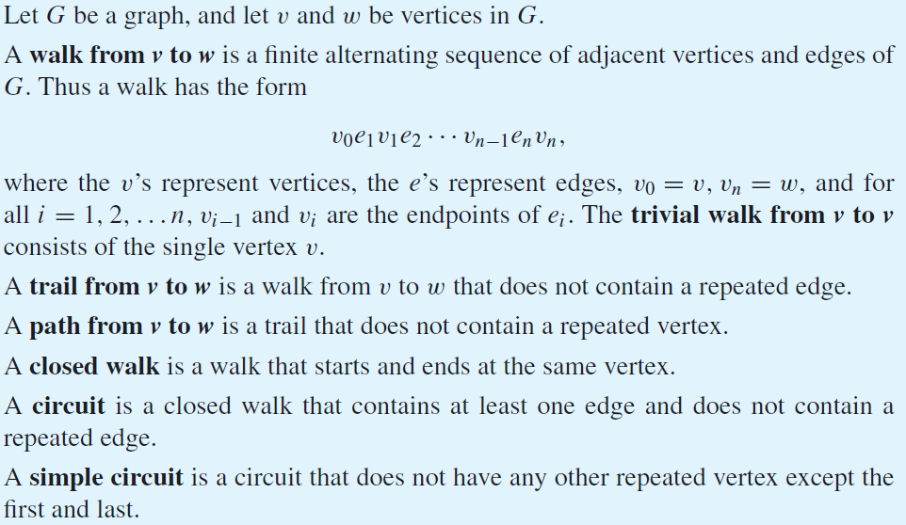
Some definitions

Slide 5
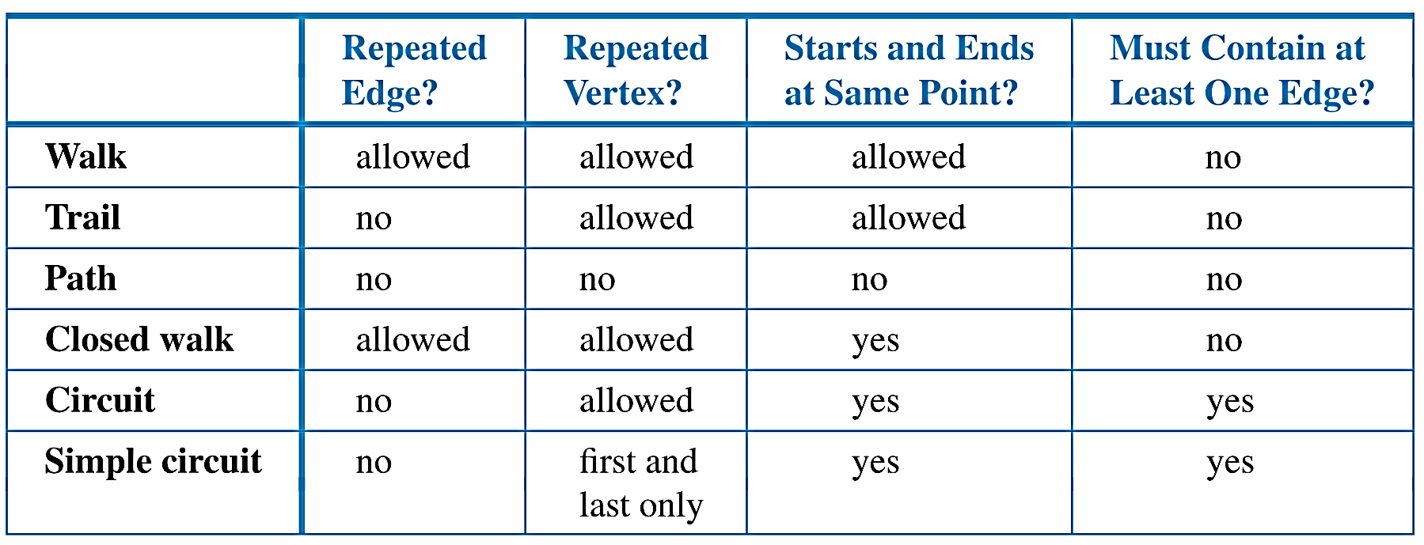
Some definitions
The definition are summarized as in the table:

Slide 6
Some definitions
Example 1:
A walk from v2 to v6
v2 e2 v3 e5 v5 e6 v4 e6 v5 e8 v6
A trail from v2 to v6
v2 e2 v3 e5 v5 e6 v4 e4 v3 e7 v6
A path from v2 to v6
v2 e2 v3 e5 v5 e8 v6
A closed walk
v2 e2 v3 e5 v5 e6 v4 e4 v3 e2 v2
A circuit which is also a simple circuit
v3 e5 v5 e8 v6 e7 v3
v1
e9
e3
v4
e10
v6
e4
e7
e8
v2
e2
e6
v3
e5
v5
e1

Slide 7
Some definitions
Example 2:
Determine which of the following walks are trails, paths, circuits, or simple circuits.
v₁ e₁ v₂ e₃ v₃ e₄ v₃ e₅ v₄
e₁ e₃ e₅ e₅ e₆
v₂ v₃ v₄ v₅ v₃ v₆ v₂
v₂ v₃ v₄ v₅ v₆ v₂
v₁ e₁ v₂ e₁ v₁
v₁
Solution:

Slide 8
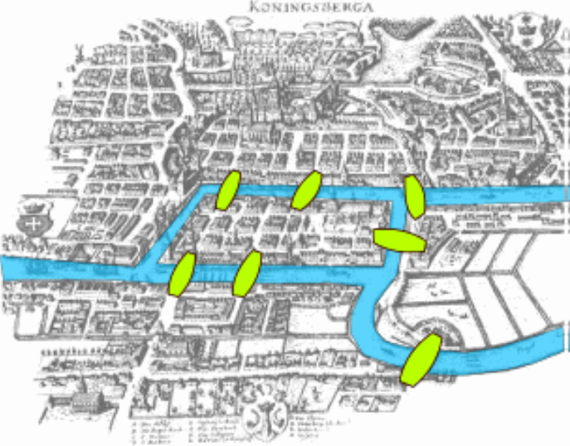
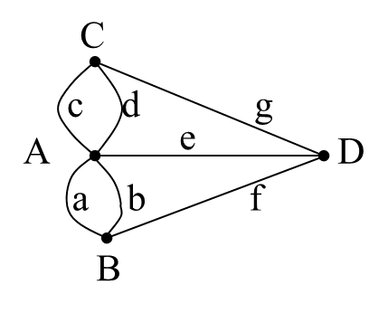
The seven bridges of Königsberg
The bridges of Königsberg problem is often regarded as the birthplace of graph theory. Leonhard Euler published a paper in 1736 giving a solution to the above puzzle. He translated the puzzle (on the left) into a graph theory problem (on the right):
Is there a simple circuit that contains every edge in the graph?
A
B
C
D

Slide 9
Euler trail and Euler circuit
Let G be a graph
An Euler trail for G is a walk of G that contains every edge of G exactly once and every vertex of G at least once.
An Euler circuit is an Euler trail that starts and ends at the same vertex.
Theorem (on the Existence of Euler Circuit)
A connected graph G has an Euler circuit if, and only if, every vertex of G has positive even degree.
Corollary (on the Existence of Euler Trail)
A connected graph has an Euler trail if and only if it has exactly two vertices with odd degree.

Slide 10
Euler trail and Euler circuit
Example 3:
Show that the graph below does not have an Euler circuit.
Solution:

Slide 11
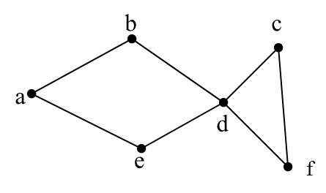
Euler trail and Euler circuit
Example 4:
Does the graph below has an Euler circuit and/or an Euler trail?
deg(a) = 2, deg(b) = 2, deg(c) = 2, deg(d) = 4, deg(e) = 2, deg(f) = 2
All vertices are even number degrees, the graph may have an Euler circuit.

Slide 12
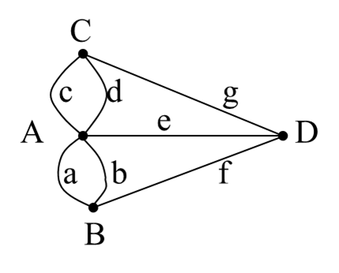
Euler trail and Euler circuit
Example 5:
Euler proved that it is impossible to cross all the 7 bridges exactly once. Why?

Slide 13
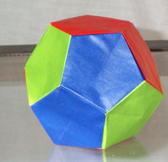
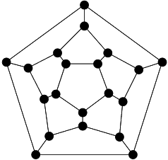
The Dodecahedron
Sir William Rowan Hamilton (1805 - 1865) invented a game called Icosian puzzle, which consisted of a wooden dodecahedron (a polyhedron with 12 regular pentagons as faces).
The 20 vertices were labeled with different cities in the world. The objective of the puzzle was to start at a city and travel along the edges of the dodecahedron, visiting each of the other 19 cities exactly once, and end back at the starting city.

Slide 14
The Dodecahedron
So the question is:
Is it possible to visit all vertices in the graph exactly once and
come back to the starting vertex again?

Slide 15
Hamiltonian path and Hamiltonian circuit
Given a graph G,
A Hamiltonian path of G is a path that passes every vertex of G exactly once.
A Hamiltonian circuit of G is a simple circuit that includes every vertex of G.
There are no known simple necessary and sufficient criteria for the existence of Hamiltonian circuits.
Certain properties can be used to show that a graph does not have a Hamiltonian circuit, for example, a graph with a vertex of degree one cannot have a Hamiltonian circuit.

Slide 16
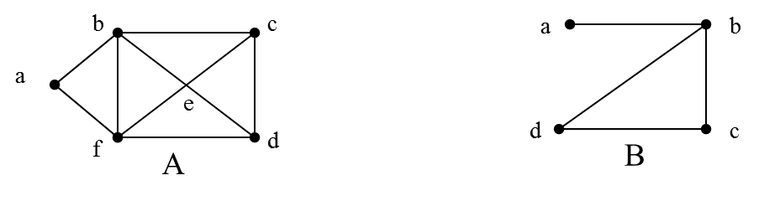
Hamiltonian circuit
Example 6:
Do the graphs below have Hamiltonian circuits?
Solution:
Graph A has a Hamiltonian circuit, namely abcdefa
Graph B does not have a Hamiltonian circuit, note that any circuit containing every vertex must contain the edge ab twice.

Slide 17
Hamiltonian circuit
Proposition:
If a graph G has a Hamiltonian circuit, then G has a subgraph H with the following properties:
1. H contains every vertex of G.
2. H is connected.
3. H has the same number of edges as vertices.
4. Every vertex of H has degree 2.
An example of such an H is shown below:
H is indicated by the black lines.

Slide 18
Hamiltonian circuit
Example 7:
Show that the graph G does not
have a Hamiltonian circuit.
Solution:
If G has a Hamiltonian circuit, then by the Proposition, G has a subgraph H that
(1) contains every vertex of G (vertices {a,b,c,d,e})
(2) is connected,
(3) has the same number of edges as vertices (five edges)
(4) is such that every vertex has degree 2.
If H exists, then two edges incident on b must be removed from G to create H. Edge {a, b} cannot be removed because if it were, vertex a would have degree less than 2 in H. Edges {e, b}, {b, a}, and {b, d} cannot be removed either with similar reason.
This contradicts the condition that every vertex in H has degree 2 in H.

Slide 19
Summary
Materials covered in this lecture?
Definition of walk, trail, path.
Definition of closed walk, circuit, simple circuit.
Definition of Euler trail and Euler circuit.
How to determine the existence of Euler trail and Euler circuit.
Definition of Hamiltonian path and Hamiltonian circuit.
How to determine the existence of Hamiltonian circuit.

Slide 20
Exercise 1
Give an example of a graph in which every vertex has degree 2, but has no Euler trail.

Slide 21
Exercise 2
Determine whether the graphs have Euler circuits. If the graph does not have an Euler circuit, explain why not. If it does have an Euler circuit, describe one.
(a)
(b)

